Slide 1






CANCER-PREDICTION

Slide 2




TEAM-MEMBERS
HEMANTH REDDY-E22CSEU0302
CHANDRA KIRAN-E22CSEU0305
SUCHARITHA-E22CSEU0324
Tip to Presenter: Set a time limit for yourself by using the timer located on the lower left side.

Slide 3




ABSTRACT
Cancer prediction is a critical area in healthcare, with the potential to save lives through early detection and risk assessment.
This project focuses on the development of an intuitive and user-friendly cancer prediction tool using Streamlit, a Python library for creating web applications

Slide 4
INTRODUCTION
In this presentation, we will explore Enhancing Cancer Prediction using Python for probability and statistical analysis. We will discuss the potential of leveraging Python for improving cancer prediction models and the impact on healthcare outcomes.

Slide 5

UNDERSTANDING CANCER-PREDICTION
Cancer prediction involves analyzing complex data to identify patterns and risk factors. Python provides powerful tools for advanced statistical analysis and probability modeling, enabling more accurate predictions and personalized treatment plans.
in this project we are using logistical regression model
for our prediction purpose

Slide 6
METHODS
1.DataCollectionandPreparation:
Gather a dataset of patient records with relevant medical information and cancer diagnosis labels (malignant or benign).
Clean and pre-process the data to handle missing values, outliers, and data type inconsistencies.
2.Feature Selection:
Identify the most relevant features from the dataset that are most predictive of cancer diagnosis.
Eliminate redundant or irrelevant features to reduce computational complexity and improve predictionaccuracy.
1.DataCollectionandPreparation:
●
Gather a dataset of patient records with relevant medical information and cancer diagnosis labels (malignant or benign).
Clean and pre-process the data to handle missing values, outliers, and data type inconsistencies.
2.Feature Selection:
●
Identify the most relevant features from the dataset that are most predictive of cancer diagnosis.
Eliminate redundant or irrelevant features to reduce computational complexity and improve predictionaccuracy.
3.Data Splitting:
●
Divide the dataset into training and testing sets.
The training set is used to train the logistic regression model, and the testing set is used to evaluate its performance.
4.Model Training:
●
Train the logistic regression model using the training set.
This involves estimating the coefficients for the logistic regression equation that best fit the training data.
5.Model Evaluation:
Evaluate the performance of the trained logistic regression model using the testing set. Common metrics used for evaluation include accuracy, precision, recall, and F1 score.

Slide 7


3.Data Splitting:
Divide the dataset into training and testing sets.
The training set is used to train the logistic regression model, and the testing set is used to evaluate its performance.
4.Model Training:
Train the logistic regression model using the training set.
This involves estimating the coefficients for the logistic regression equation that best fit the training data.
5.Model Evaluation:
Evaluate the performance of the trained logistic regression model using the testing set. Common metrics used for evaluation include accuracy, precision, recall, and F1 score.

Slide 8
Libraries that are imported
import streamlit as st import joblib
import pandas as pd
import plotly.graph_objects as go
import numpy as np
import pandas as pd
from sklearn.preprocessing import StandardScaler
from sklearn.model_selection import train_test_split from sklearn.linear_model import LogisticRegression
from sklearn.metrics import accuracy_score,classification_report import joblib

Slide 9
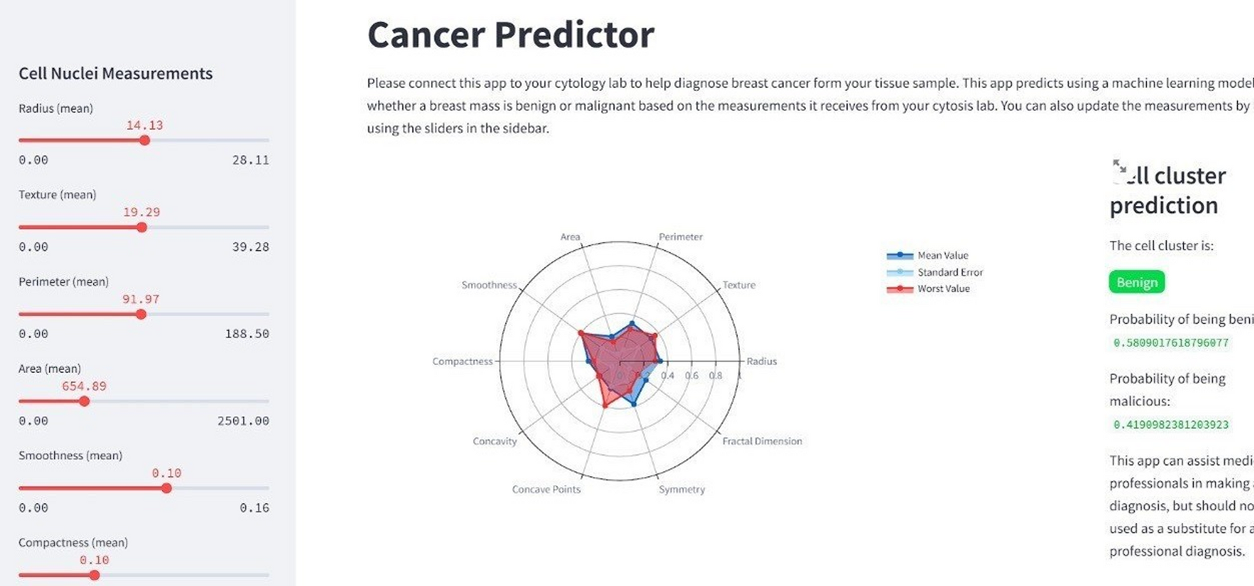
RESULT

Slide 10
CONCLUSION
In conclusion, leveraging Python for a probability and statistical analysis holds great promise in enhancing cancer prediction. By harnessing the power of Python, we can improve the accuracy of prediction models and ultimately contribute to more effective cancer diagnosis and treatment.

Slide 11
Thank you

